Slide 1
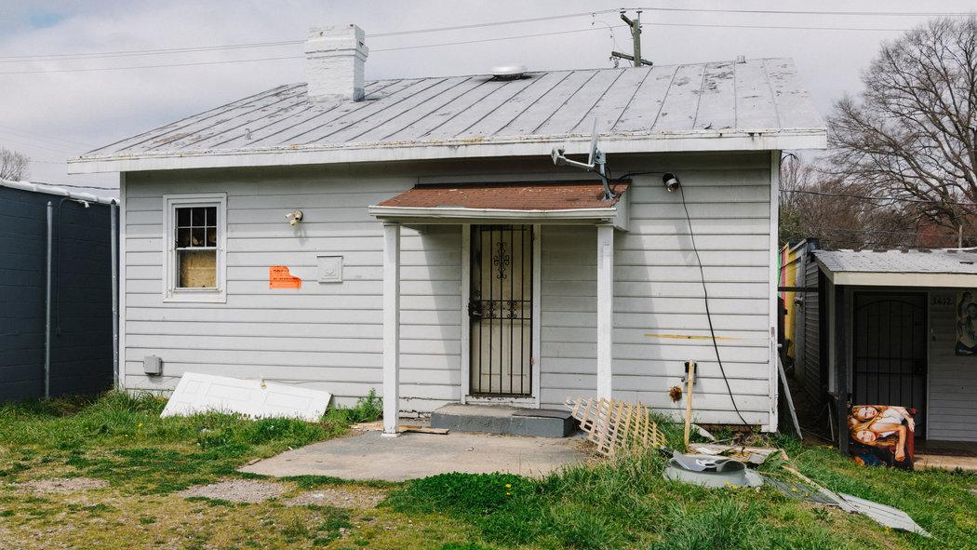
Evictions as Indicator of Housing Security
Data Hack/Challenge Group 5
SDSS 2019

Slide 2
Background
Eviction is a scalable indicator of housing insecurity
In 2016, 2.3 million evictions were filed in the U.S.
Eviction is a cause of poverty and homelessness.
Eviction has negative impacts on job, physical and mental health, and healthcare costs.
Notes:
1. https://www.npr.org/2018/04/12/601783346/first-ever-evictions-database-shows-were-in-the-middle-of-a-housing-crisis
2. https://scholar.harvard.edu/files/mdesmond/files/desmondgershenson.ssr_.2016.pdf
3. https://howhousingmatters.org/articles/why-we-need-to-stop-evictions-before-they-happen/

Slide 3
Research questions
What demographic variables explain/predict housing security (measured by eviction) in Washington state?
How does housing security (measured by eviction) vary across counties in Washington state?

Slide 4
Methods
Dataset from The Evictions Lab, summarized by county (N= 667 with complete data) from 2000 - 2016
Outcomes
Eviction rate
Demographic (internal) variables
Ethnicity
Total evictions
Poverty (median income, rent burden)
External variables
Community size
Renting, vs. owning, property

Slide 5
Results: Correlates of eviction rate
Eviction was more common in tracts with high levels of poverty, and less common in tracts whose residents were mostly white or who owned the property.
(Spearman’s rank from 0.18 - 0.62)
...and slightly more common in more-populous tracts.
(Spearman’s rank 0.11 for population)
However, corrected models could not be run due to extreme non-normality of outcome.

Slide 6
Results: Average of Eviction Rate in King County during 2000 - 2016

Slide 7
Results: Average of Poverty Rate in King County during 2000 - 2016

Slide 8
--> Caution
Evictions are rare and catastrophic events
A few census tracts made up almost all the evictions studied;
Median rate of evictions was about 0.55%; range was 0-40%;
Median number of evictions was just over 1 in the follow-up period: range was 0-60.
As a result, prediction is difficult
Effects will almost always be driven by extreme-valued points.

Slide 9
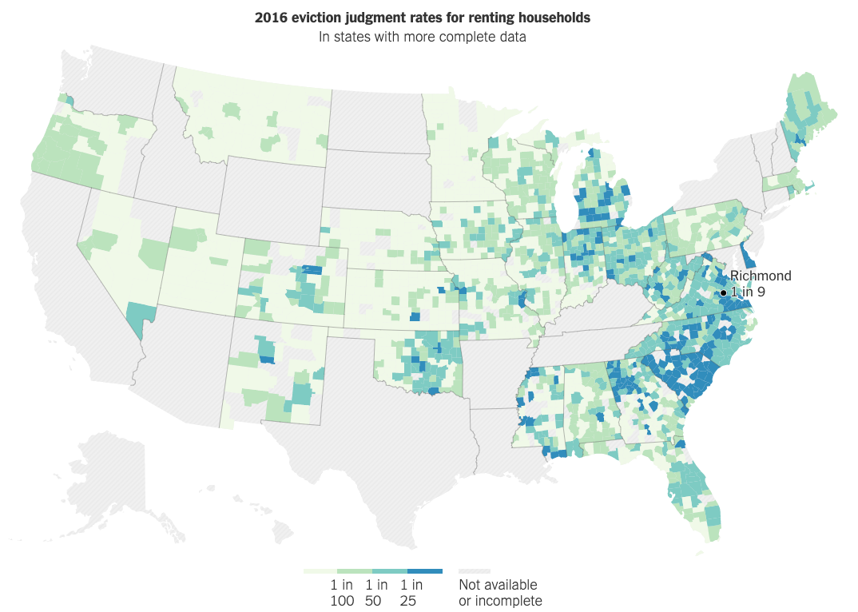
Badger, E. & Bui Q. (2018, April 7). In 83 Million Eviction Records, a Sweeping and Intimate New Look at Housing in America. The New York Times.

Slide 10
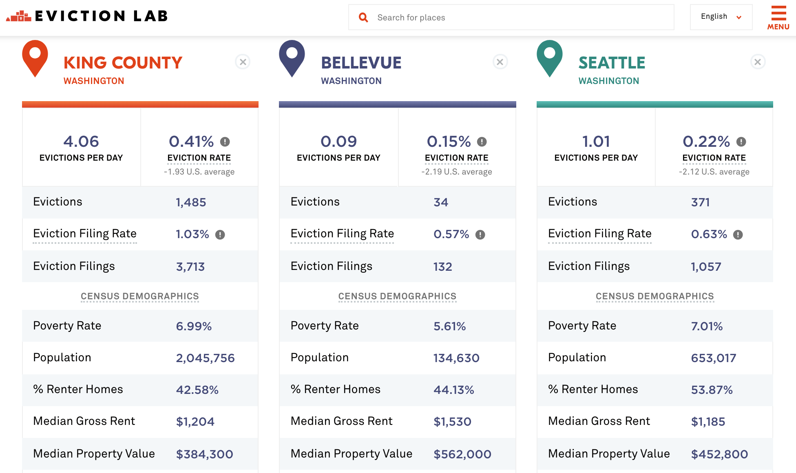

Slide 11
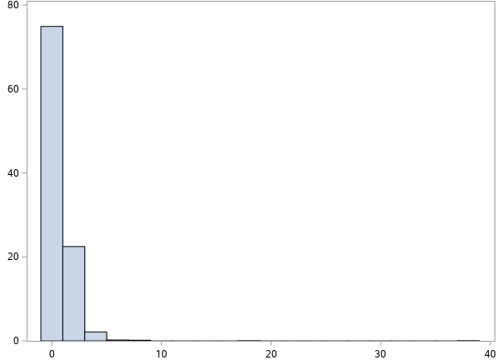
Results: Eviction Rates in King County
Eviction Rate by Census Tract, Percent
Percent of total tracts

Slide 12
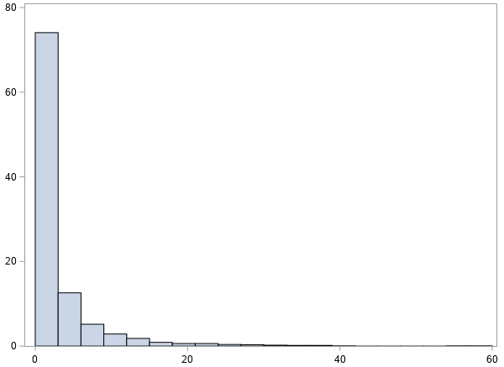
Results: Total Evictions in King County
Total Evictions per Tract
Percent of tracts

Slide 13
Conclusions
A few tracts (‘hotspots’) make up much of the eviction burden of King County.
Interventions can safely focus on those counties.
Risk factors for eviction include poverty, ethnicity, and community size: however corrected models could not be run.

Slide 14
Further Research
Eviction is associated with poverty
Cause or effect?
Which marker of poverty most important? How to model this non-normal outcome?
Risks for eviction: solely renters or do landlords share blame?
Factors affecting decision to evict a problem tenant: is there evidence of racism / classism?

